Slide 1
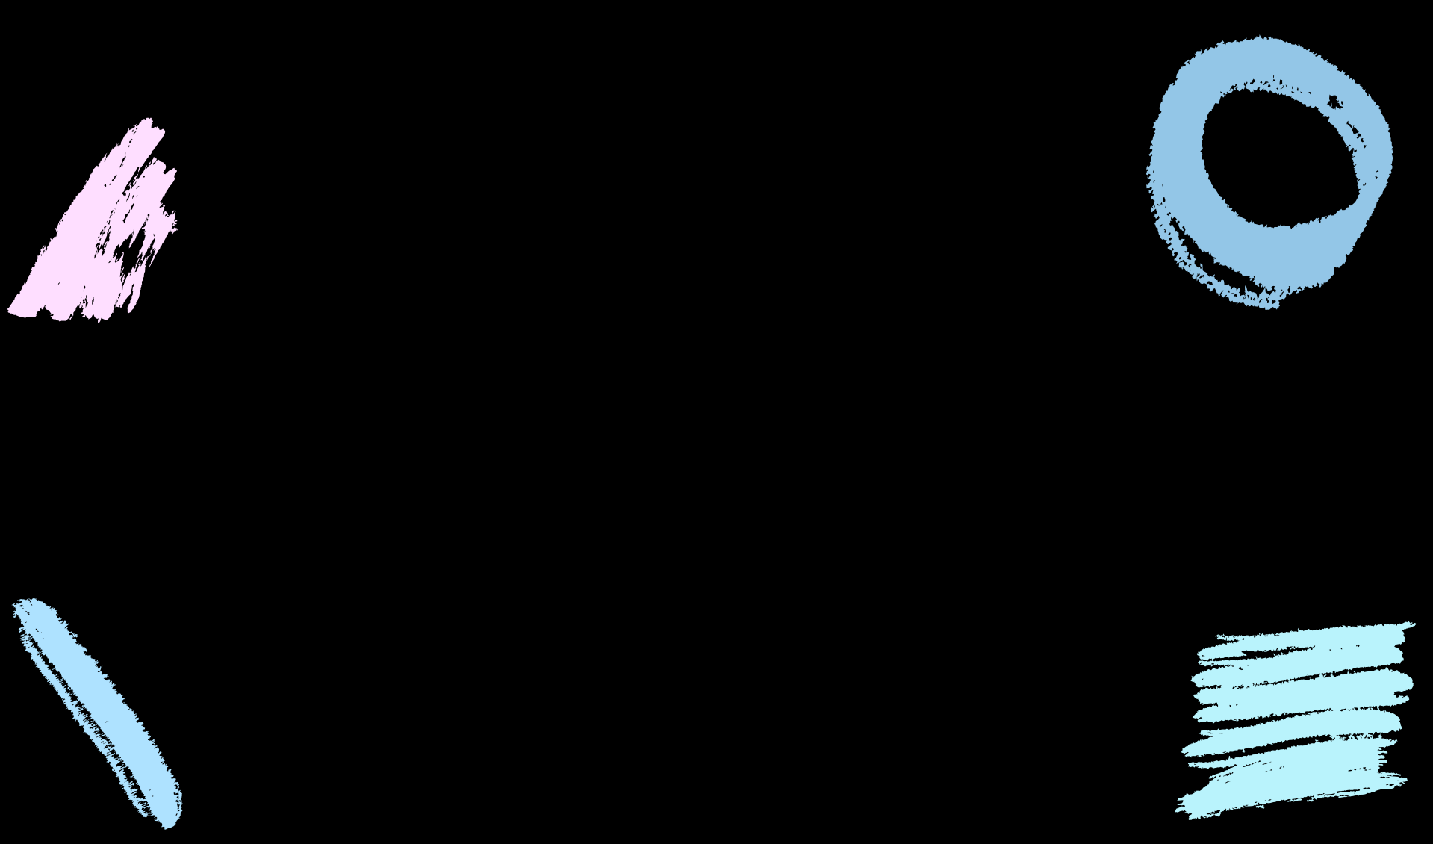
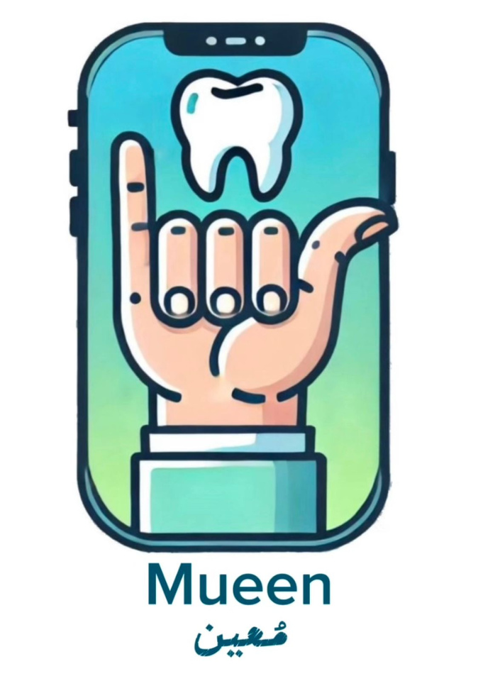
Saudi Sign Language Translation

Slide 2


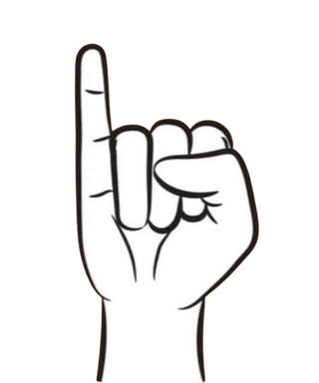
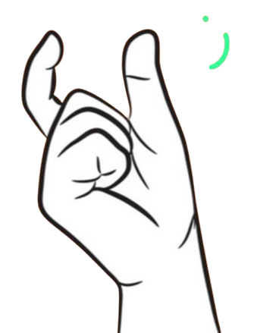
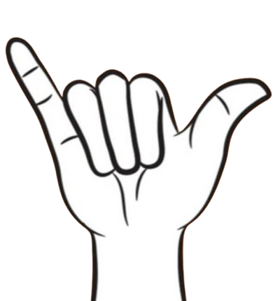

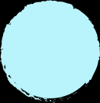
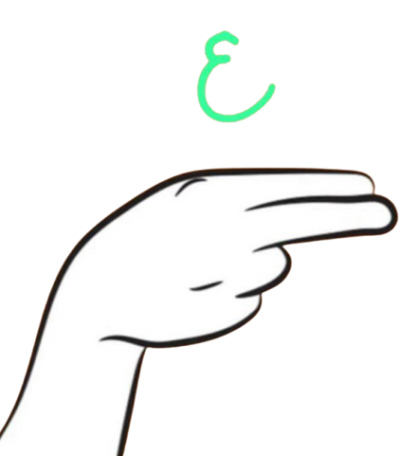
Group members:
Hadeel Bakhshwen 2006299
Jood Kawther 2009599
Shahad Alharthi 2105261
Almaha abdulwahab 2009018

Slide 3
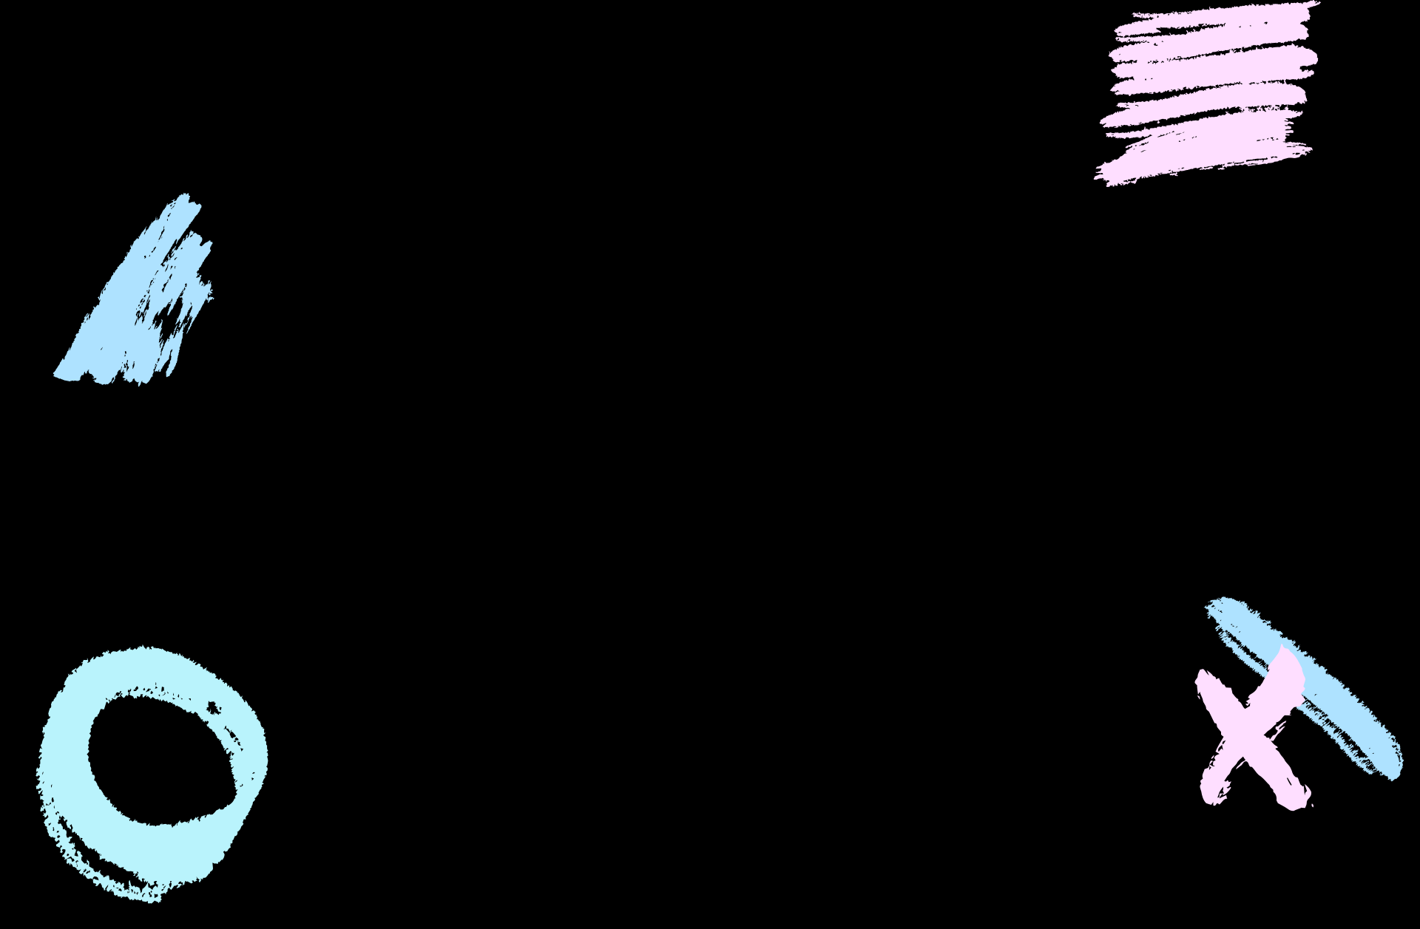
TABLE OF CONTENTS
01
02
03
04
Introduction
Features
Design of the System
Testing
05
06
07
08
Project Limitation
Future Work
Results
Conclusions

Slide 4
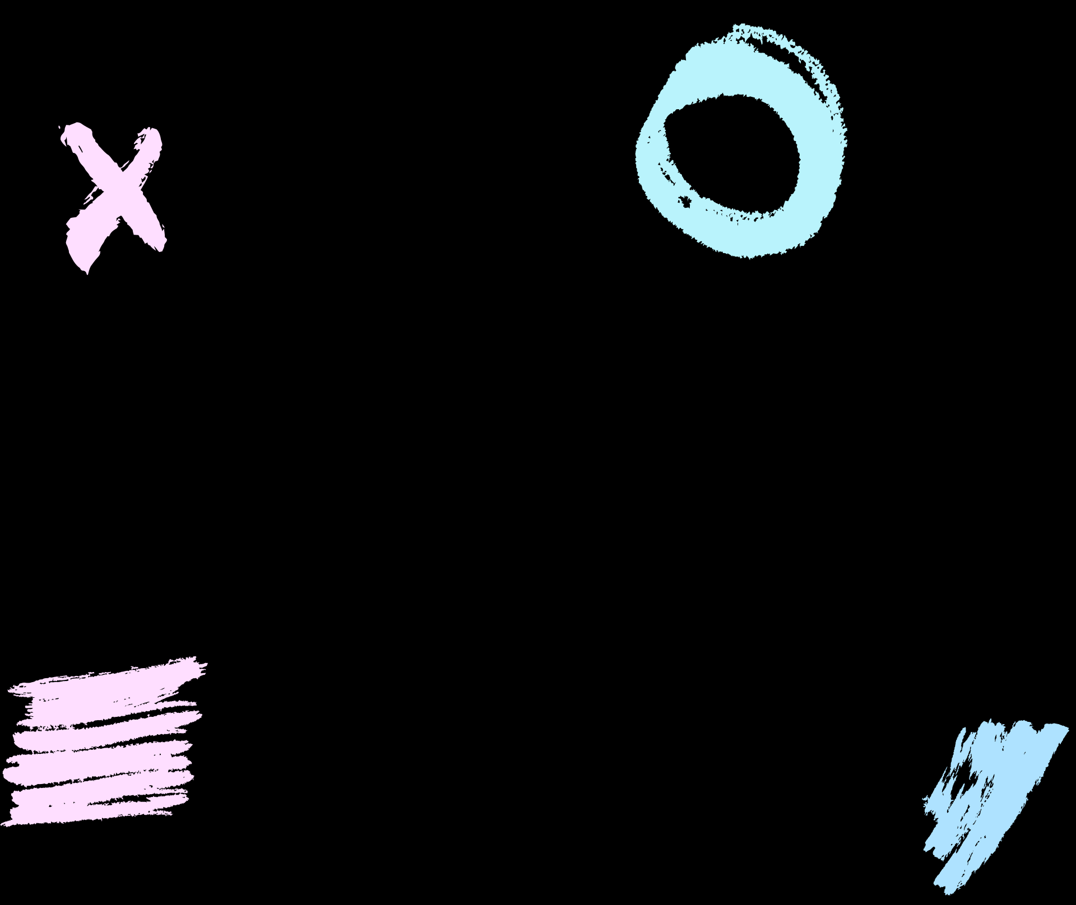
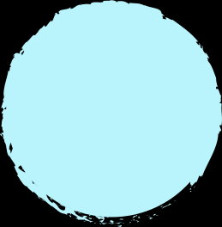
01
Introduction
By: Hadeel Bakhshwen

Slide 5
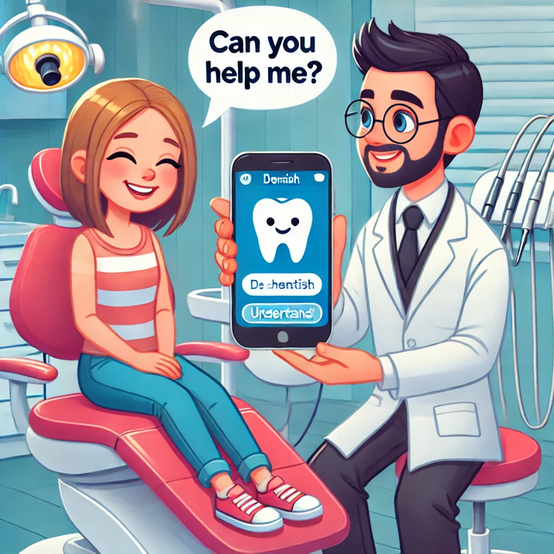
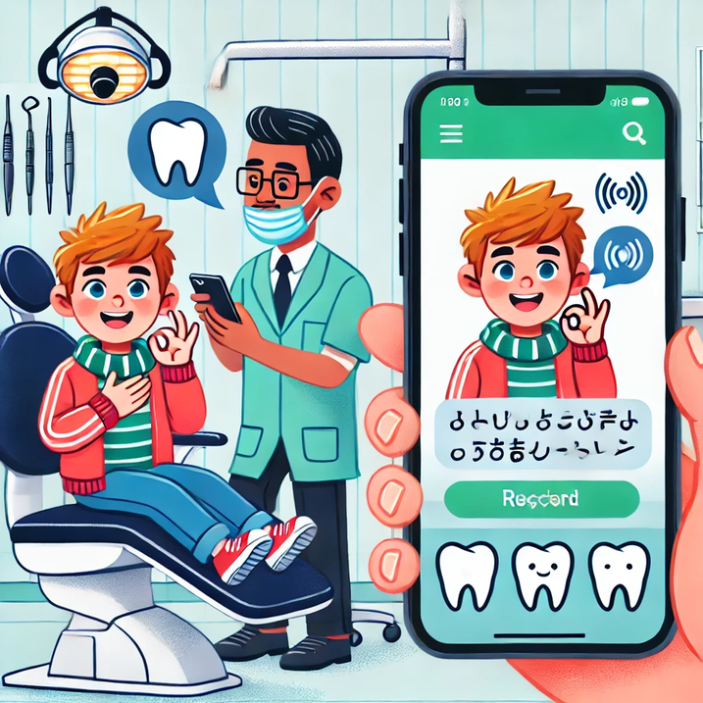
Mueen App is a specialized communication tool for dental clinics, bridging the gap between hearing-impaired patients and medical staff. It translates sign language into text and optionally into audio for smoother interactions.

Slide 6
02
Features
By: Hadeel Bakhshwen

Slide 7
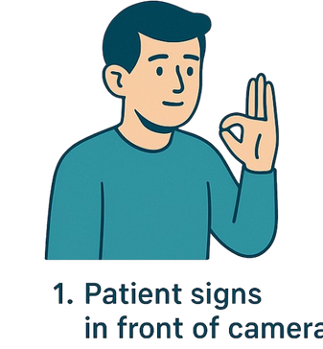
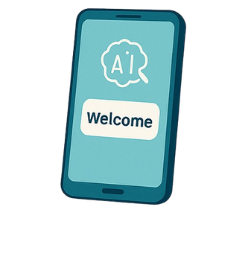
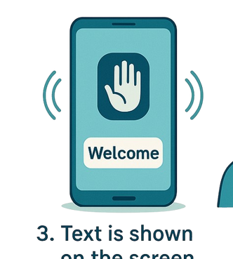
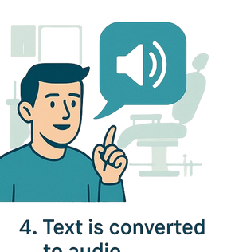
The user performs a SSL gesture in front of the device’s camera
2. The gesture is analyzed using a trained AI model to recognize its meaning
3.Translated gesture appears as text
4. Text is converted into speech

Slide 8
03
Design of the System

Slide 9

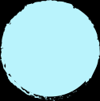
UseCase Diagram
3.A
By: Hadeel Bakhshwen

Slide 10
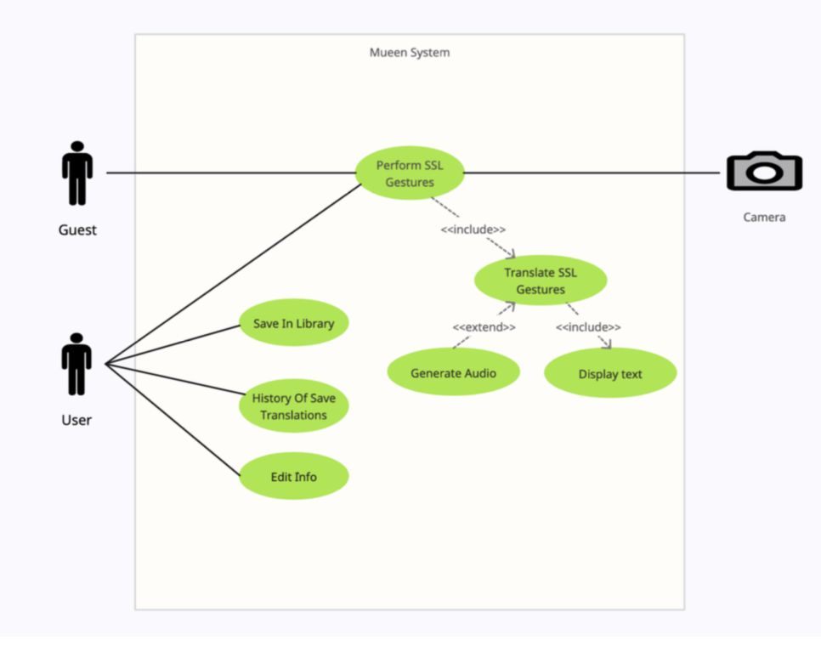

Slide 11
Class Diagram
3.B
By: Shahad Alharthi

Slide 12
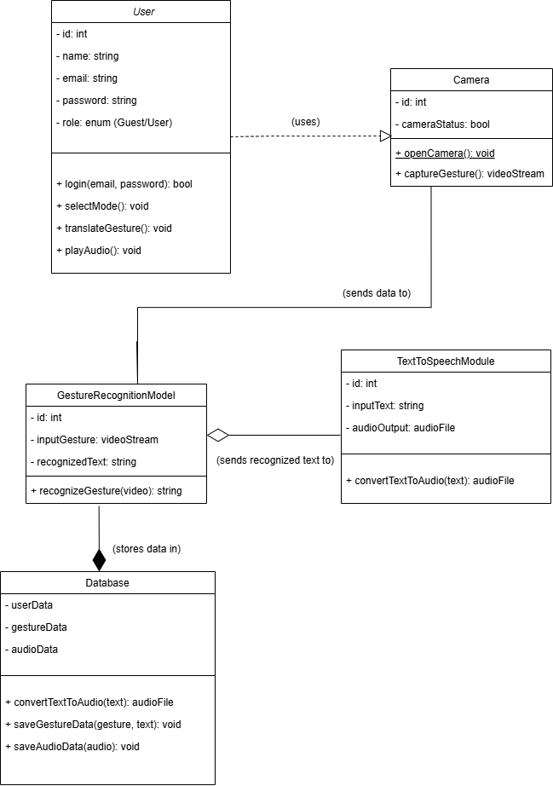

Slide 13
ER Diagram
3.D
By: Almaha abdulwahab

Slide 14
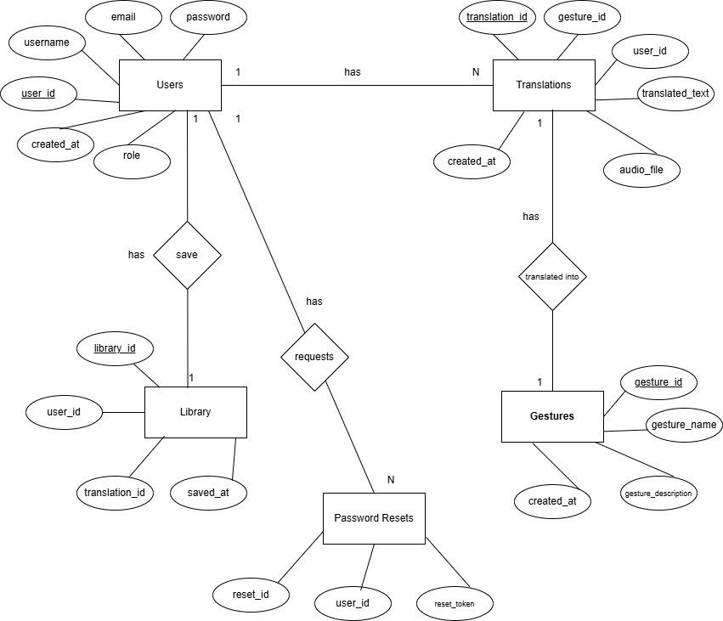
ER Diagram
before update

Slide 15
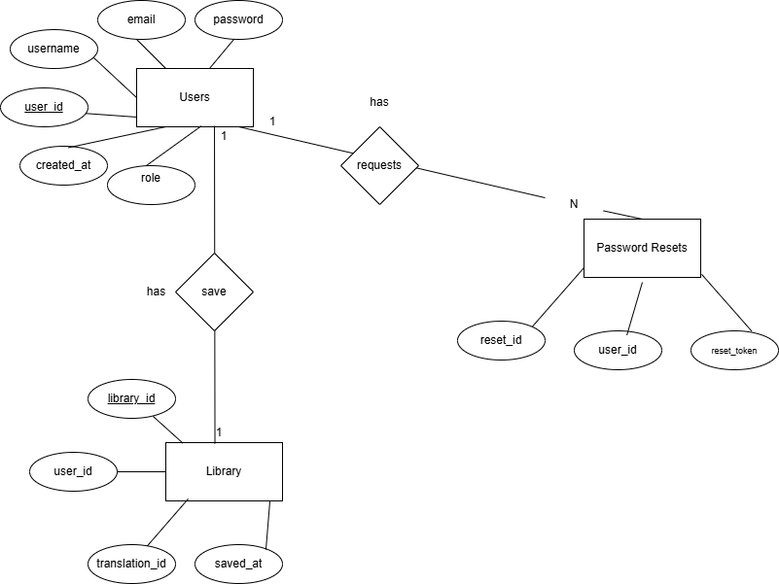
ER Diagram after update

Slide 16
04
Testing
By: Jood Kawther

Slide 17
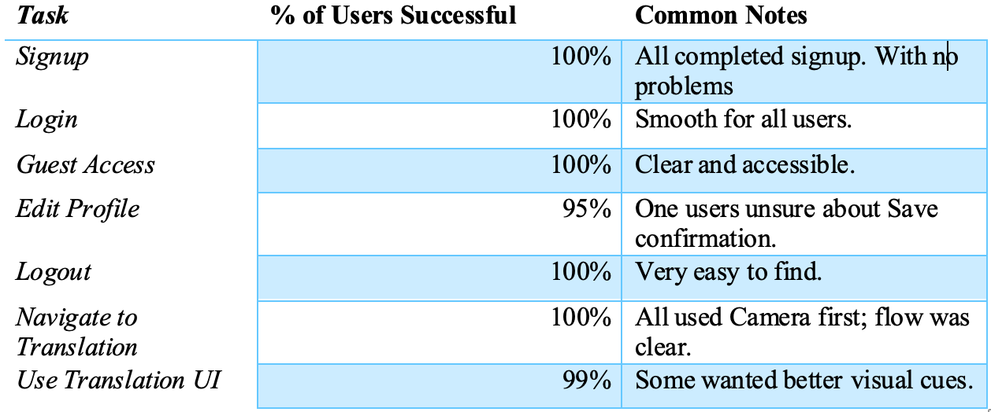
Usability Testing
Usability Summary Table
Users rated the app between 4.8 and 5 stars.
The UI was described as clean, with intuitive flow
All tasks were completed without help.
One suggestion: add clearer cues on the translation screen after using the camera.
Overall, the experience was smooth and positive.

Slide 18
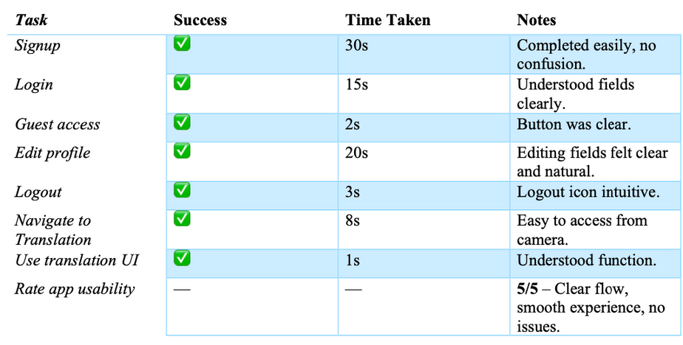
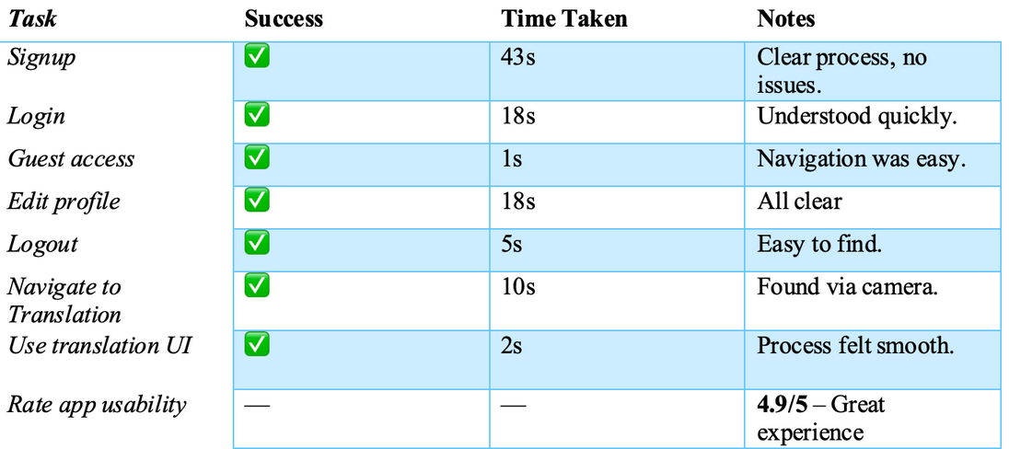
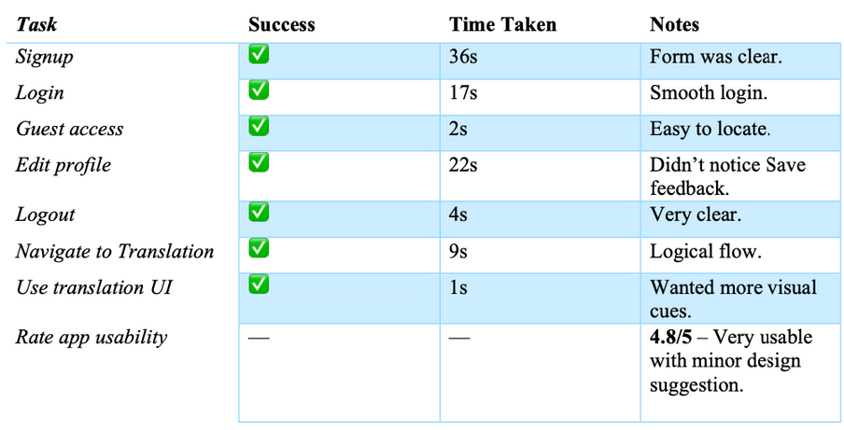
Usability Testing
User A
User B
User C

Slide 19
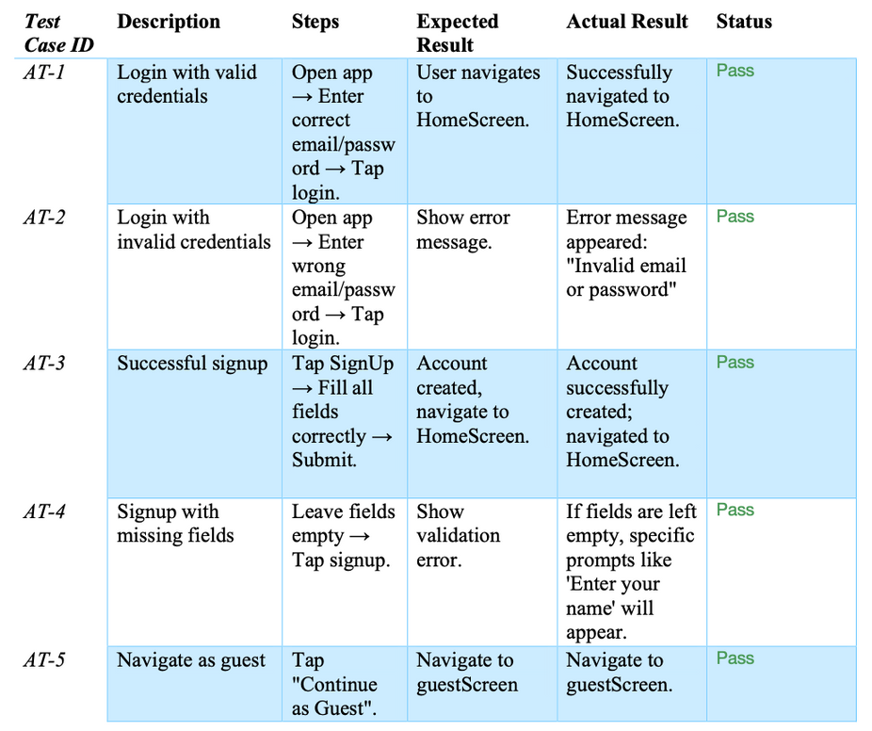
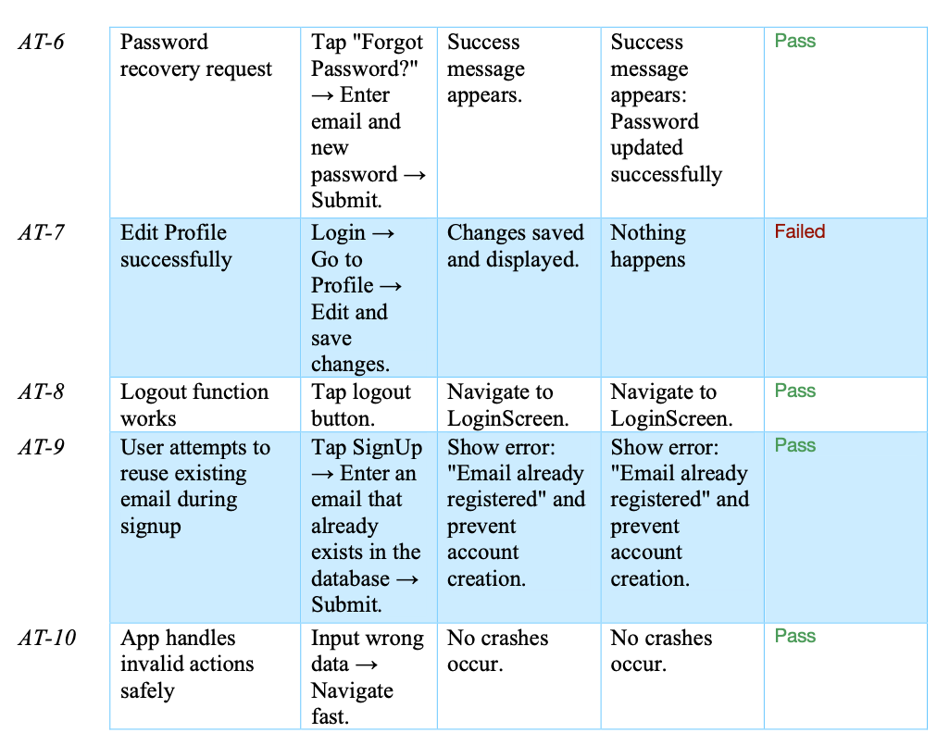
Acceptance Testing

Slide 20
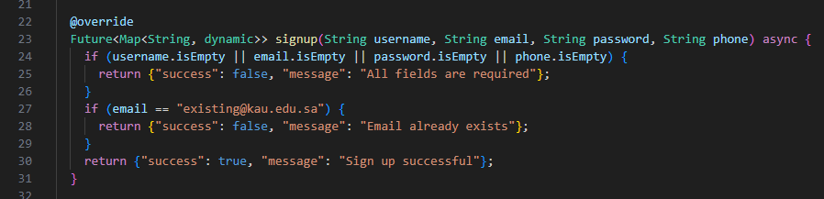
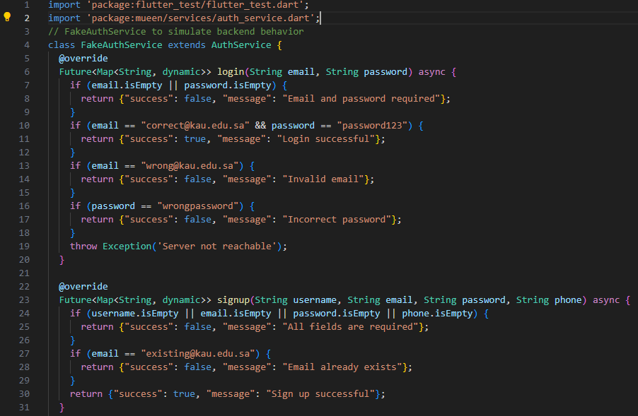
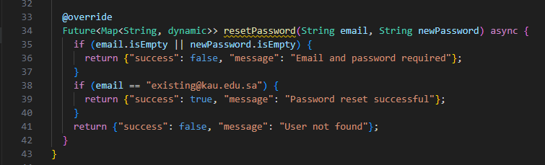
Unit Testing

Slide 21
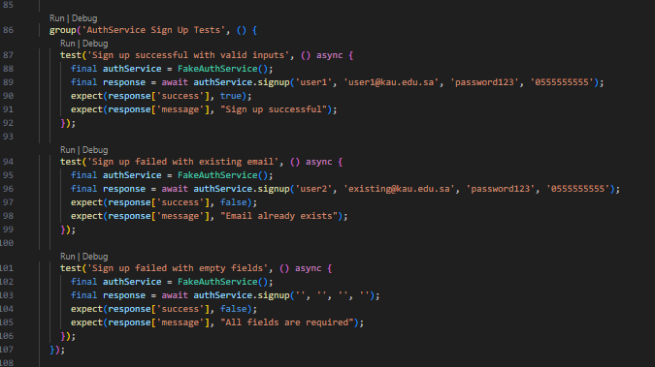
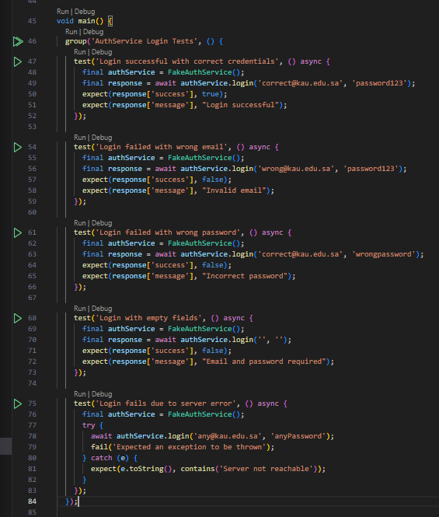
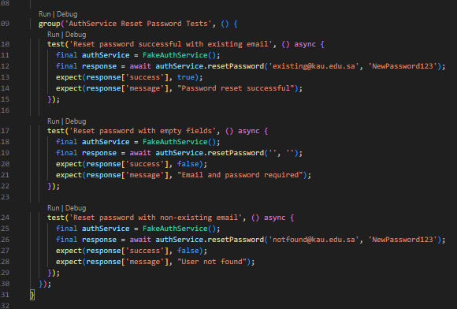

Slide 22
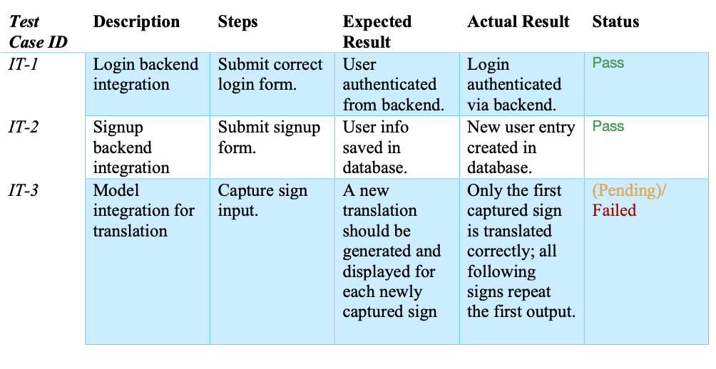
Integration Testing

Slide 23
05
Project Limitation
By: Almaha abdulwahab

Slide 24
1
We used a small scope of around 50 signs only.
However, many other important words are used in dental clinics that are not included in our system.

Slide 25
2
Our application uses the camera to detect signs.
But since we trained the model with only two people, the accuracy is low when other users try it.

Slide 26
3
We planned to convert the sign into voice,
but the voice feature did not work in the final version.

Slide 27
4
The camera needs good lighting and a clear background.
If the place is too dark or messy, the app may not detect the sign correctly.

Slide 28
06
Future Work
By: Almaha abdulwahab

Slide 29
1
We plan to increase the scope of our app.
It will not be limited to dental clinics only, but can be used in other medical fields too.

Slide 30
2
We will improve the camera detection to work better in different lighting and positions.

Slide 31
3
We want to support different Arabic dialects, not just the Saudi dialect.
This will make the app more useful in other Arabic-speaking countries.

Slide 32
4
We aim to adapt the app for use not only in hospitals and clinics, but also in schools for deaf students, to help teachers communicate with them more effectively.

Slide 33
07
Results
By: Shahad Alharthi

Slide 34
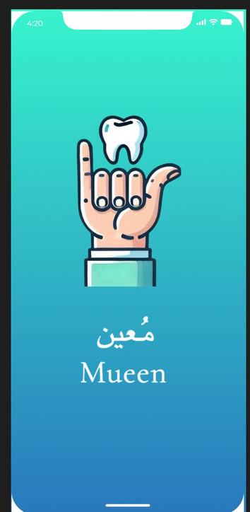
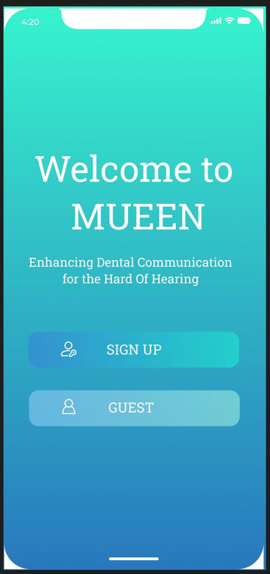
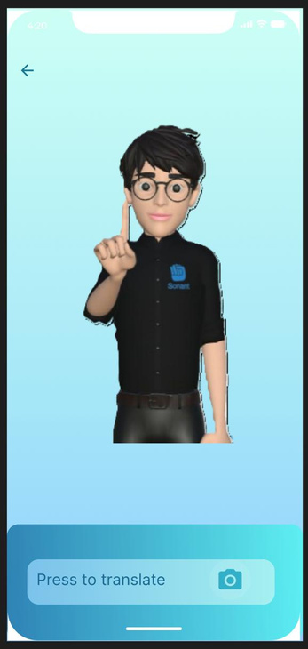
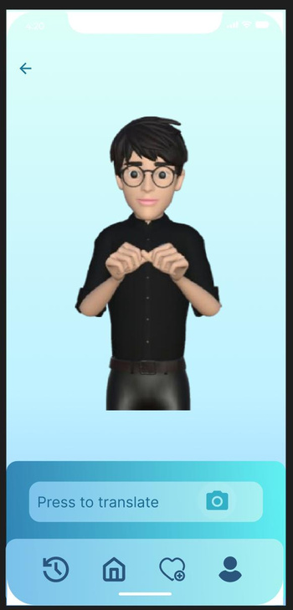
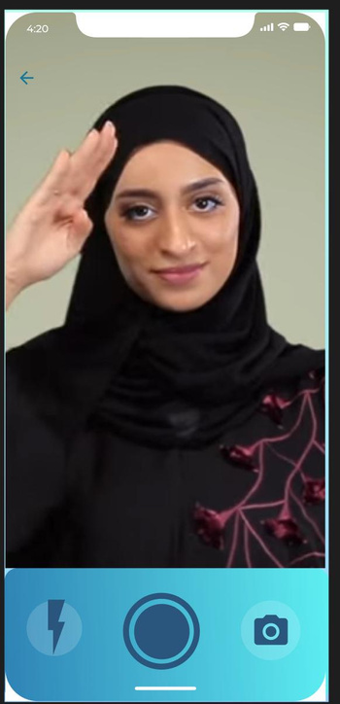
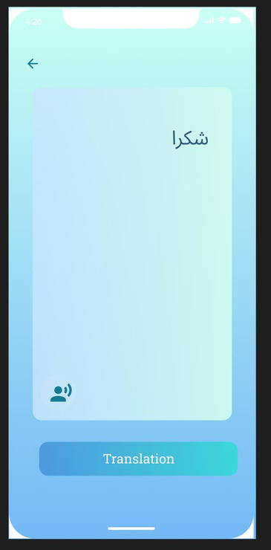

Slide 35
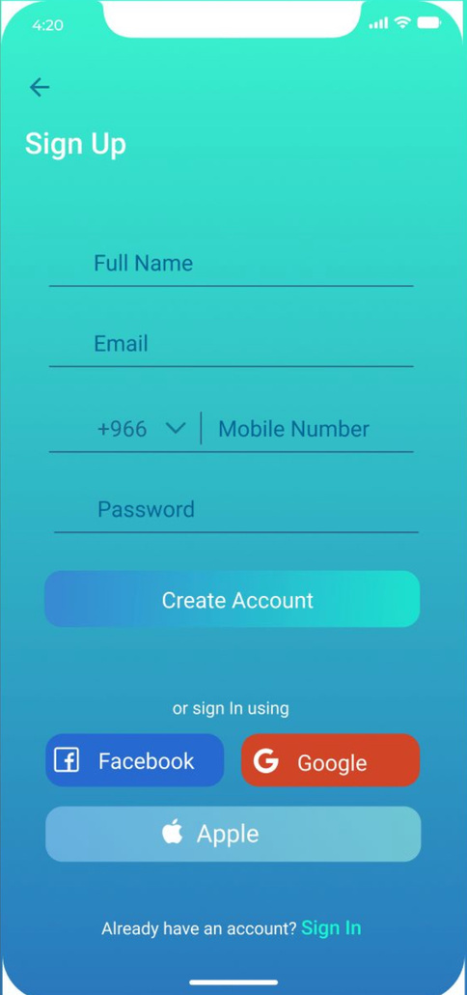
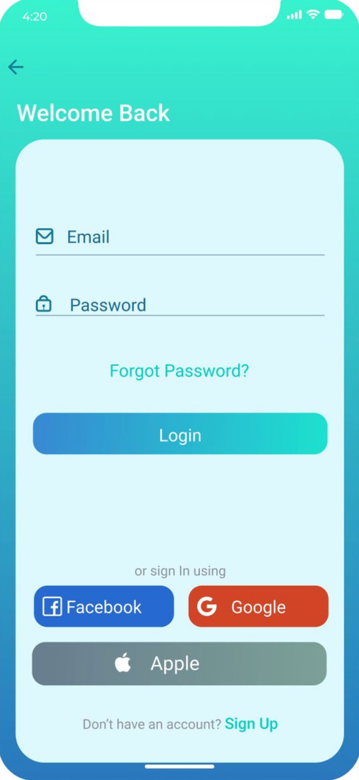
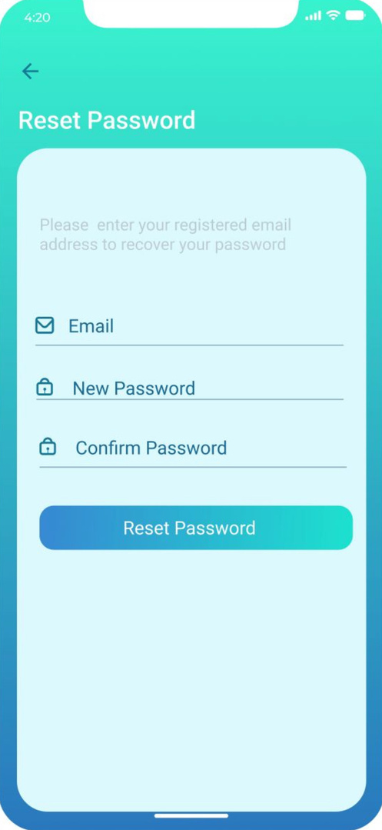
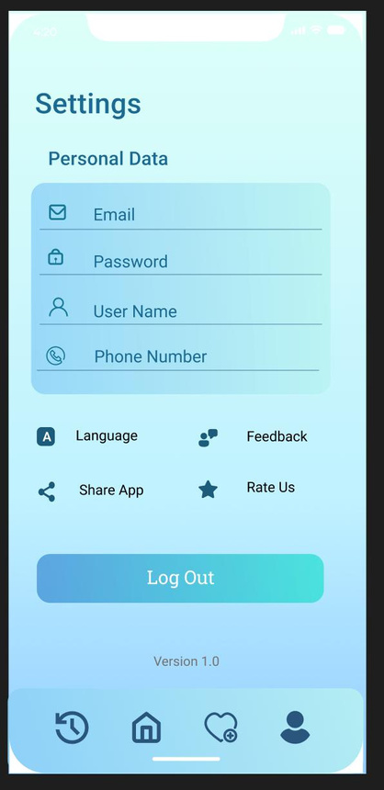

Slide 36
08
Conclusions
By: Jood Kawther

Slide 37
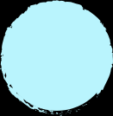
Mueen was built to bridge communication gaps — starting with dental clinics, but aiming much further.
This is just the beginning of what inclusive technology can look like.
Thank you for being part of our journey.
And well, just to end it our way:
void main() {
print("Mueen project: Completed ✅");
print("Future goals: Just getting started 🚀");
}

